Slide 1
CSCE 5580 – Computer Networks
Final Review
Instructor: Tao Wang

Slide 2

Topics
IP: the Internet Protocol
Routing protocols
Intra-ISP routing: OSPF
routing among ISPs: BGP
Internet Control Message Protocol
Multiple access protocols
LANs
Principles of cryptography
Message integrity, authentication
Securing e-mail
Securing TCP connections: TLS
Firewalls and IDS

Slide 3
Network-layer service model
Quality of Service (QoS) Guarantees ?
Network
Architecture
Internet
ATM
ATM
Internet
Internet
Service
Model
best effort
Constant Bit Rate
Available Bit Rate
Intserv Guaranteed
(RFC 1633)
Diffserv (RFC 2475)
Bandwidth
none
Constant rate
Guaranteed min
yes
possible
Loss
no
yes
no
yes
possibly
Order
no
yes
yes
yes
possibly
Timing
no
yes
no
yes
no

Slide 4
IP Datagram format
32 bits
IP protocol version number
head.
len
type of
service
total datagram
length (bytes)
ver
length
header length(bytes)
“type” of service:
diffserv (0:5)
ECN (6:7)
flgs
fragment
offset
fragmentation/
reassembly
16-bit identifier
time to
live
upper
layer
header
checksum
header checksum
TTL: remaining max hops
(decremented at each router)
source IP address
32-bit source IP address
destination IP address
Maximum length: 64K bytes
Typically: 1500 bytes or less
upper layer protocol (e.g., TCP or UDP)
32-bit destination IP address
overhead
options (if any)
e.g., timestamp, record route taken
20 bytes of TCP
20 bytes of IP
= 40 bytes + app layer overhead for TCP+IP
payload data
(variable length,
typically a TCP
or UDP segment)

Slide 5

IP addressing: introduction
223.1.1.1
IP address: 32-bit identifier associated with each host or router interface
interface: connection between host/router and physical link
  router’s typically have multiple interfaces
  host typically has one or two interfaces (e.g., wired Ethernet, wireless 802.11)
223.1.2.1
223.1.1.2
223.1.1.4
223.1.2.9
223.1.1.3
223.1.3.27
223.1.2.2
223.1.3.1
223.1.3.2
dotted-decimal IP address notation:
223.1.1.1 = 11011111 00000001 00000001 00000001
223
1
1
1

Slide 6

IP addressing: introduction
223.1.1.1
Q: how are interfaces actually connected?
223.1.2.1
223.1.1.2
A: we’ll learn about that in chapters 6, 7
A: wired
Ethernet interfaces connected by Ethernet switches
223.1.1.4
223.1.2.9
223.1.1.3
223.1.3.27
223.1.2.2
223.1.3.1
223.1.3.2
For now: don’t need to worry about how one interface is connected to another (with no intervening router)
A: wireless WiFi interfaces connected by WiFi base station

Slide 7
Subnets
223.1.1.1
What’s a subnet ?
  device interfaces that can physically reach each other without passing through an intervening router
223.1.2.1
223.1.1.2
223.1.1.4
223.1.2.9
223.1.1.3
223.1.3.27
223.1.2.2
IP addresses have structure:
  subnet part: devices in same subnet have common high order bits
  host part: remaining low order bits
223.1.3.1
223.1.3.2
network consisting of 3 subnets

Slide 8
IP addressing: CIDR
CIDR: Classless InterDomain Routing (pronounced “cider”)
  subnet portion of address of arbitrary length
  address format: a.b.c.d/x, where x is # bits in subnet portion of address
subnet
part
host
part
11001000 00010111 00010000 00000000
200.23.16.0/23
Notes:
What is subnet path, what is host path

Slide 9
Subnets
223.1.1.2
subnet 223.1.1/24
where are the subnets?
what are the /24 subnet addresses?
223.1.1.1
223.1.1.4
223.1.1.3
223.1.9.2
223.1.7.0
subnet 223.1.7/24
subnet 223.1.9/24
223.1.9.1
223.1.7.1
223.1.8.1
223.1.8.0
subnet 223.1.2/24
223.1.2.6
subnet 223.1.8/24
223.1.3.27
subnet 223.1.3/24
223.1.2.1
223.1.2.2
223.1.3.1
223.1.3.2

Slide 10


DHCP: example
DHCP
DHCP
UDP
IP
Eth
Phy
Connecting laptop will use DHCP to get IP address, address of first-hop router, address of DNS server.
DHCP
DHCP
DHCP
DHCP
DHCP REQUEST message encapsulated in UDP, encapsulated in IP, encapsulated in Ethernet
DHCP
DHCP
UDP
IP
Eth
Phy
168.1.1.1
DHCP
DHCP
DHCP
Ethernet frame broadcast (dest: FFFFFFFFFFFF) on LAN, received at router running DHCP server
DHCP
router with DHCP
server built into
router
Ethernet de-mux’ed to IP de-mux’ed, UDP de-mux’ed to DHCP

Slide 11
DHCP: example
DHCP
UDP
IP
Eth
Phy
DCP server formulates DHCP ACK containing client’s IP address, IP address of first-hop router for client, name & IP address of DNS server
DHCP
DHCP
DHCP
DHCP
encapsulated DHCP server reply forwarded to client, de-muxing up to DHCP at client
DHCP
DHCP
UDP
IP
Eth
Phy
DHCP
DHCP
DHCP
router with DHCP
server built into
router
client now knows its IP address, name and IP address of DNS server, IP address of its first-hop router
DHCP

Slide 12
NAT: network address translation
NAT: all devices in local network share just one IPv4 address as far as outside world is concerned
rest of
Internet
local network (e.g., home network) 10.0.0/24
10.0.0.1
138.76.29.7
10.0.0.4
10.0.0.2
10.0.0.3
all datagrams leaving local network have same source NAT IP address: 138.76.29.7, but different source port numbers
datagrams with source or destination in this network have 10.0.0/24 address for source, destination (as usual)
Notes:
How to host more devices

Slide 13
NAT: network address translation
  all devices in local network have 32-bit addresses in a “private” IP address space (10/8, 172.16/12, 192.168/16 prefixes) that can only be used in local network
  advantages:
    just one IP address needed from provider ISP for all devices
    can change addresses of host in local network without notifying outside world
    can change ISP without changing addresses of devices in local network
    security: devices inside local net not directly addressable, visible by outside world

Slide 14
NAT: network address translation
implementation: NAT router must (transparently):
  outgoing datagrams: replace (source IP address, port #) of every outgoing datagram to (NAT IP address, new port #)
      remote clients/servers will respond using (NAT IP address, new port #) as destination address
  remember (in NAT translation table) every (source IP address, port #) to (NAT IP address, new port #) translation pair
  incoming datagrams: replace (NAT IP address, new port #) in destination fields of every incoming datagram with corresponding (source IP address, port #) stored in NAT table

Slide 15
NAT: network address translation
NAT translation table
WAN side addr LAN side addr
2: NAT router changes datagram source address from 10.0.0.1, 3345 to 138.76.29.7, 5001,
updates table
1: host 10.0.0.1 sends datagram to 128.119.40.186, 80
138.76.29.7, 5001 10.0.0.1, 3345
…… ……
S: 10.0.0.1, 3345
D: 128.119.40.186, 80
10.0.0.1
1
2
S: 138.76.29.7, 5001
D: 128.119.40.186, 80
10.0.0.4
10.0.0.2
138.76.29.7
S: 128.119.40.186, 80
D: 10.0.0.1, 3345
4
S: 128.119.40.186, 80
D: 138.76.29.7, 5001
3
10.0.0.3
3: reply arrives, destination address: 138.76.29.7, 5001

Slide 16
IPv6 datagram format
flow label: identify datagrams in same "flow.” (concept of “flow” not well defined).
32 bits
priority: identify priority among datagrams in flow
ver
pri
flow label
payload len
next hdr
hop limit
source address
(128 bits)
128-bit
IPv6 addresses
destination address
(128 bits)
payload (data)
What’s missing (compared with IPv4):
no checksum (to speed processing at routers)
no fragmentation/reassembly
no options (available as upper-layer, next-header protocol at router)

Slide 17
Graph abstraction: link costs
5
c_{a,b}: cost of direct link connecting a and b
e.g., c_{w,z} = 5, c_{u,z} = ∞
  cost defined by network operator: could always be 1, or inversely related to bandwidth, or inversely related to congestion
v
3
w
2
5
u
2
1
z
3
1
2
x
y
1
graph: G = (N,E)
N: set of routers = { u, v, w, x, y, z }
E: set of links ={ (u,v), (u,x), (v,x), (v,w), (x,w), (x,y), (w,y), (w,z), (y,z) }

Slide 18
Dijkstra’s link-state routing algorithm
centralized: network topology, link costs known to all nodes
  accomplished via “link state broadcast”
  all nodes have same info
computes least cost paths from one node (“source”) to all other nodes
  gives forwarding table for that node
iterative: after k iterations, know least cost path to k destinations
notation
c_{x,y}: direct link cost from node x to y; = ∞ if not direct neighbors
D(v): current estimate of cost of least-cost-path from source to destination v
p(v): predecessor node along path from source to v
N': set of nodes whose least-cost-path definitively known

Slide 19
Dijkstra’s algorithm: an example
v
w
x
y
z
Step
0
1
2
3
4
5
N'
D(v),p(v)
D(w),p(w)
D(x),p(x)
D(y),p(y)
D(z),p(z)
u
2,u
5,u
1,u
∞
∞
D(w),p(w)
5,u
4,x
3,y
3,y
5
Initialization (step 0):
For all a: if a adjacent to u then D(a) = c_{u,a}
v
3
w
2
5
u
2
1
z
3
1
2
x
y
1

Slide 20
Dijkstra’s algorithm: an example
5
v
3
w
2
5
u
2
1
z
3
1
2
D(w),p(w)
5,u
4,x
3,y
3,y
x
y
1
resulting least-cost-path tree from u:
resulting forwarding table in u:
v
w
destination
outgoing link
v
x
y
w
x
(u,v)
(u,x)
(u,x)
(u,x)
(u,x)
route from u to v directly
u
z
x
route from u to all other destinations via x
y

Slide 21
Internet approach to scalable routing
aggregate routers into regions known as “autonomous systems” (AS) (a.k.a. “domains”)
intra-AS (aka “intra-domain”): routing among routers within same AS (“network”)
all routers in AS must run same intra-domain protocol
routers in different AS can run different intra-domain routing protocols
gateway router: at “edge” of its own AS, has link(s) to router(s) in other AS’es
inter-AS (aka “inter-domain”): routing among AS’es
gateways perform inter-domain routing (as well as intra-domain routing)

Slide 22
Intra-AS routing: routing within an AS
most common intra-AS routing protocols:
RIP: Routing Information Protocol [RFC 1723]
  classic DV: DVs exchanged every 30 secs
  no longer widely used
EIGRP: Enhanced Interior Gateway Routing Protocol
  DV based
  formerly Cisco-proprietary for decades (became open in 2013 [RFC 7868])
OSPF: Open Shortest Path First [RFC 2328]
  link-state routing

Slide 23

Interconnected ASes
intra-AS
routing
3c
3a
inter-AS routing
2c
3b
2a
intra-AS
routing
1c
2b
AS3
intra-AS
routing
1a
1b
AS2
1d
AS1
intra-AS (aka “intra-domain”): routing among routers within same AS (“network”)
inter-AS (aka “inter-domain”): routing among AS’es
Notes:
Each router then locally runs Dijkstra’s shortest-path algorithm to determine a shortest-path tree to all subnets, with itself as the root node.

Slide 24
Internet inter-AS routing: BGP
BGP (Border Gateway Protocol): the de facto inter-domain routing protocol
  “glue that holds the Internet together”
allows subnet to advertise its existence, and the destinations it can reach, to rest of Internet: “I am here, here is who I can reach, and how”
BGP provides each AS a means to:
  obtain destination network reachability info from neighboring ASes (eBGP)
  determine routes to other networks based on reachability information and policy
  propagate reachability information to all AS-internal routers (iBGP)
  advertise (to neighboring networks) destination reachability info
Notes:
Since an inter-AS routing protocol involves coordination among multiple ASs, communicating ASs must run the same inter-AS routing protocol. In fact, in the Internet, all ASs run the same inter-AS routing protocol, called the Border Gateway Protocol, more commonly known as BGP

Slide 25
BGP route selection
router may learn about more than one route to destination AS, selects route based on:
  local preference value attribute: policy decision
  shortest AS-PATH
  closest NEXT-HOP router: hot potato routing
  additional criteria

Slide 26
Why different Intra-, Inter-AS routing ?
policy:
inter-AS: admin wants control over how its traffic routed, who routes through its network
intra-AS: single admin, so policy less of an issue
scale:
hierarchical routing saves table size, reduced update traffic
performance:
intra-AS: can focus on performance
inter-AS: policy dominates over performance

Slide 27
MAC protocols: taxonomy
three broad classes:
channel partitioning
  divide channel into smaller “pieces” (time slots, frequency, code)
  allocate piece to node for exclusive use
random access
  channel not divided, allow collisions
  “recover” from collisions
“taking turns”
  nodes take turns, but nodes with more to send can take longer turns

Slide 28
CSMA (carrier sense multiple access)
simple CSMA: listen before transmit:
  if channel sensed idle: transmit entire frame
  if channel sensed busy: defer transmission
human analogy: don’t interrupt others!
CSMA/CD: CSMA with collision detection
  collisions detected within short time
  colliding transmissions aborted, reducing channel wastage
  collision detection easy in wired, difficult with wireless
human analogy: the polite conversationalist
Notes:
How it works

Slide 29


CSMA: collisions
spatial layout of nodes
collisions can still occur with carrier sensing:
  propagation delay means two nodes may not hear each other’s just-started transmission
collision: entire packet transmission time wasted
  distance & propagation delay play role in in determining collision probability

Slide 30

CSMA/CD:
spatial layout of nodes
CSMA/CD reduces the amount of time wasted in collisions
  transmission aborted on collision detection

Slide 31
Ethernet CSMA/CD algorithm
Ethernet receives datagram from network layer, creates frame
If Ethernet senses channel:
  if idle: start frame transmission.
  if busy: wait until channel idle, then transmit
If entire frame transmitted without collision - done!
If another transmission detected while sending: abort, send jam signal
After aborting, enter binary (exponential) backoff:
  after mth collision, chooses K at random from {0,1,2, …, 2^{m}-1}. Ethernet waits K·512 bit times, returns to Step 2
  more collisions: longer backoff interval

Slide 32
MAC addresses
32-bit IP address:
  network-layer address for interface
  used for layer 3 (network layer) forwarding
  e.g.: 128.119.40.136
MAC (or LAN or physical or Ethernet) address:
  function: used “locally” to get frame from one interface to another physically-connected interface (same subnet, in IP-addressing sense)
  48-bit MAC address (for most LANs) burned in NIC ROM, also sometimes software settable
  e.g.: 1A-2F-BB-76-09-AD
hexadecimal (base 16) notation
(each “numeral” represents 4 bits)

Slide 33
ARP: address resolution protocol
Question: how to determine interface’s MAC address, knowing its IP address?
ARP table: each IP node (host, router) on LAN has table
ARP
137.196.7.78
  IP/MAC address mappings for some LAN nodes:
< IP address; MAC address; TTL>
  TTL (Time To Live): time after which address mapping will be forgotten (typically 20 min)
1A-2F-BB-76-09-AD
ARP
ARP
LAN
71-65-F7-2B-08-53
58-23-D7-FA-20-B0
137.196.7.23
137.196.7.14
ARP
0C-C4-11-6F-E3-98
137.196.7.88

Slide 34
ARP protocol in action
example: A wants to send datagram to B
  B’s MAC address not in A’s ARP table, so A uses ARP to find B’s MAC address
A broadcasts ARP query, containing B's IP addr
  destination MAC address = FF-FF-FF-FF-FF-FF
  all nodes on LAN receive ARP query
1
Ethernet frame (sent to FF-FF-FF-FF-FF-FF)
C
Source MAC: 71-65-F7-2B-08-53
Source IP: 137.196.7.23
Target IP address: 137.196.7.14
…
ARP table in A
IP addr
MAC addr
TTL
TTL
A
B
1
71-65-F7-2B-08-53
58-23-D7-FA-20-B0
137.196.7.23
137.196.7.14
D

Slide 35
ARP protocol in action
example: A wants to send datagram to B
  B’s MAC address not in A’s ARP table, so A uses ARP to find B’s MAC address
ARP message into Ethernet frame (sent to 71-65-F7-2B-08-53)
C
Target IP address: 137.196.7.14
Target MAC address:
58-23-D7-FA-20-B0
…
ARP table in A
IP addr
MAC addr
TTL
TTL
A
B
2
71-65-F7-2B-08-53
58-23-D7-FA-20-B0
137.196.7.23
137.196.7.14
2
B replies to A with ARP response, giving its MAC address
D

Slide 36
ARP protocol in action
example: A wants to send datagram to B
  B’s MAC address not in A’s ARP table, so A uses ARP to find B’s MAC address
C
ARP table in A
IP addr
MAC addr
TTL
TTL
A
B
137.196.
7.14
58-23-D7-FA-20-B0
500
71-65-F7-2B-08-53
58-23-D7-FA-20-B0
137.196.7.23
137.196.7.14
3
A receives B’s reply, adds B entry into its local ARP table
D

Slide 37

Routing to another subnet: addressing
walkthrough: sending a datagram from A to B via R
  focus on addressing – at IP (datagram) and MAC layer (frame) levels
  assume that:
    A knows B’s IP address
    A knows IP address of first hop router, R (how?)
    A knows R’s MAC address (how?)
A
R
B
111.111.111.111
74-29-9C-E8-FF-55
222.222.222.222
49-BD-D2-C7-56-2A
222.222.222.220
1A-23-F9-CD-06-9B
111.111.111.112
111.111.111.110
CC-49-DE-D0-AB-7D
E6-E9-00-17-BB-4B
222.222.222.221
88-B2-2F-54-1A-0F

Slide 38
Ethernet switch
Switch is a link-layer device: takes an active role
  store, forward Ethernet (or other type of) frames
  examine incoming frame’s MAC address, selectively forward frame to one-or-more outgoing links when frame is to be forwarded on segment, uses CSMA/CD to access segment
transparent: hosts unaware of presence of switches
plug-and-play, self-learning
  switches do not need to be configured

Slide 39
Switch: multiple simultaneous transmissions
hosts have dedicated, direct connection to switch
switches buffer packets
Ethernet protocol used on each incoming link, so:
  no collisions; full duplex
  each link is its own collision domain
A
C’
B
1
2
6
3
5
4
B’
C
A’
switching: A-to-A’ and B-to-B’ can transmit simultaneously, without collisions
switch with six interfaces (1,2,3,4,5,6)

Slide 40
Switch forwarding table
Q: how does switch know A’ reachable via interface 4, B’ reachable via interface 5?
A
C’
B
A: each switch has a switch table, each entry:
  (MAC address of host, interface to reach host, time stamp)
  looks like a routing table!
1
2
6
3
5
4
B’
C
A’
Q: how are entries created, maintained in switch table?
  something like a routing protocol?

Slide 41
Switch: self-learning
Source: A
switch learns which hosts can be reached through which interfaces
Dest: A’
A A’
A
C’
B
  when frame received, switch “learns” location of sender: incoming LAN segment
1
2
6
3
5
4
  records sender/location pair in switch table
B’
C
A’
Switch table
(initially empty)
MAC addr interface TTL
A
1
60

Slide 42
Self-learning, forwarding: example
Source: A
Dest: A’
frame destination, A’, location unknown:
A A’
flood
A
C’
B
destination A location known:
selectively send
on just one link
1
2
6
A A’
A A’
A A’
A A’
A A’
3
5
4
B’
C
A’ A
A’
MAC addr interface TTL
A
1
60
switch table
(initially empty)
A’
4
60

Slide 43


Interconnecting switches
self-learning switches can be connected together:
S₄
S₁
S₃
A
S₂
F
I
B
C
D
E
G
H
Q: sending from A to G - how does S₁ know to forward frame destined to G via S₄ and S₃?
A: self learning! (works exactly the same as in single-switch case!)

Slide 44
Switches vs. routers
application
transport
network
link
physical
both are store-and-forward:
routers: network-layer devices (examine network-layer headers)
switches: link-layer devices (examine link-layer headers)
datagram
frame
link
physical
frame
switch
network
link
physical
datagram
both have forwarding tables:
routers: compute tables using routing algorithms, IP addresses
switches: learn forwarding table using flooding, learning, MAC addresses
frame
application
transport
network
link
physical
6-44

Slide 45





A day in the life: scenario
scenario:
DNS server
arriving mobile client attaches to network …
browser
Comcast network
68.80.0.0/13
requests web page: www.google.com
school network
68.80.2.0/24
web page
Sounds
simple!
web server
Google’s network
64.233.160.0/19
64.233.169.105

Slide 46
What is network security?
confidentiality: only sender, intended receiver should “understand” message contents
  sender encrypts message
  receiver decrypts message
authentication: sender, receiver want to confirm identity of each other
message integrity: sender, receiver want to ensure message not altered (in transit, or afterwards) without detection
access and availability: services must be accessible and available to users

Slide 47

Public Key Cryptography
symmetric key crypto:
requires sender, receiver know shared secret key
Q: how to agree on key in first place (particularly if never “met”)?
public key crypto
radically different approach [Diffie-Hellman76, RSA78]
sender, receiver do not share secret key
public encryption key known to all
private decryption key known only to receiver

Slide 48


Public Key Cryptography
+
Bob’s public key
K
B
-
Bob’s private key
K
B
plaintext
message, m
encryption
algorithm
ciphertext
decryption
algorithm
plaintext
+
-
+
K (m)
m = K (K (m))
B
B
B
Wow - public key cryptography revolutionized 2000-year-old (previously only symmetric key) cryptography!
similar ideas emerged at roughly same time, independently in US and UK (classified)

Slide 49
Public key encryption algorithms
requirements:
+
.
-
.
1
need K ( ) and K ( ) such that
B
B
-
+
K (K (m)) = m
B
B
+
2
given public key K , it should be impossible to compute private key K
B
-
B
RSA: Rivest, Shamir, Adelson algorithm

Slide 50

Authentication: a modified third try
Goal: Bob wants Alice to “prove” her identity to him
Protocol ap3.0: Alice says “I am Alice” and sends her encrypted secret password to “prove” it.
Alice’s
IP addr
encrypted
password
“I am Alice”
failure scenario??
Alice’s
IP addr
OK

Slide 51
Authentication: a modified third try
Goal: Bob wants Alice to “prove” her identity to him
Protocol ap3.0: Alice says “I am Alice” and sends her encrypted secret password to “prove” it.
Alice’s
IP addr
encrypted
password
“I am Alice”
playback attack still works: Trudy records Alice’s packet
and later plays it back to Bob
Alice’s
IP addr
encrypted
password
“I am Alice”
Alice’s
IP addr
OK

Slide 52
Authentication: a fourth try
Goal: avoid playback attack
nonce: number (R) used only once-in-a-lifetime
protocol ap4.0: to prove Alice “live”, Bob sends Alice nonce, R
Alice must return R, encrypted with shared secret key
“I am Alice”
R
K (R)
Bob know Alice is live, and only Alice knows key to encrypt nonce, so it must be Alice!
A-B
Failures, drawbacks?

Slide 53
Authentication: ap5.0
ap4.0 requires shared symmetric key - can we authenticate using public key techniques?
ap5.0: use nonce, public key cryptography
“I am Alice”
R
Bob computes
+
-
-
K
(K (R)) = R
K (R)
A
A
A
and knows only Alice could have the private key, that encrypted R such that
Send me your public key
+
K (R)
+
-
A
K
A
(K (R)) = R
A

Slide 54
Authentication: ap5.0 – there’s still a flaw!
man (or woman) in the middle attack: Trudy poses as Alice (to Bob) and as Bob (to Alice)
I am Alice
I am Alice
?
R
-
K (R)
T
R
Where are mistakes made here?
Send me your public key
-
+
K (R)
K
Bob computes
A
T
+
-
Send me your public key
K
(K (R)) = R,
+
T
T
K
authenticating
Trudy as Alice
A
Trudy recovers m:
+
+
-
+
K (m)
Trudy recovers Bob’s m:
m = K (K (m))
Bob sends a personal message, m to Alice
-
+
K (m)
T
T
m = K (K (m))
A
T
A
A
sends m to Alice encrypted with Alice’s public key
and she and Bob meet a week later in person and discuss m, not knowing Trudy knows m

Slide 55
Public key Certification Authorities (CA)
certification authority (CA): binds public key to particular entity, E
entity (person, website, router) registers its public key with CE provides “proof of identity” to CA
  CA creates certificate binding identity E to E’s public key
  certificate containing E’s public key digitally signed by CA: CA says “this is E’s public key”
Bob’s
public
key
digital
signature
(encrypt)
+
+
K
K
B
B
CA’s
private
key
-
certificate for Bob’s public key, signed by CA
Bob’s
identifying information
K
CA
Notes:
How public key authentication works
Given senarior, its authentication or not

Slide 56
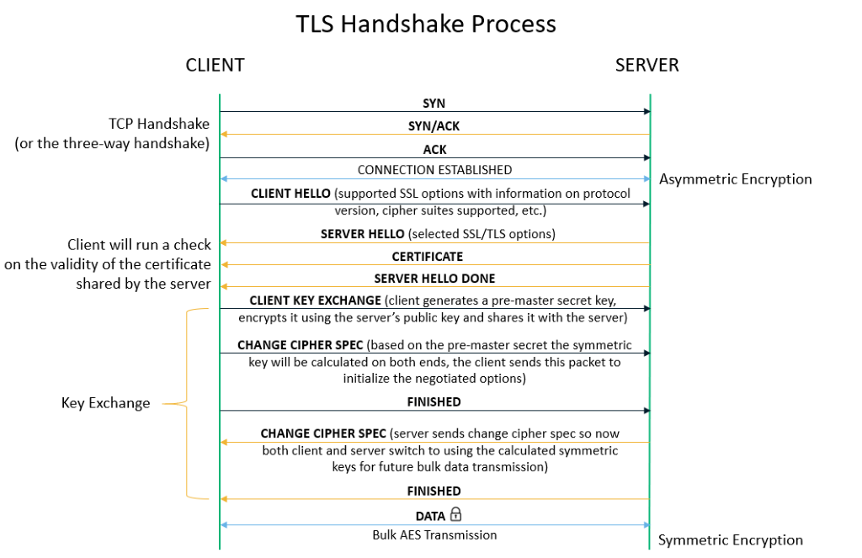
HTTPS

Slide 57

Digital signatures
cryptographic technique analogous to hand-written signatures:
sender (Bob) digitally signs document: he is document owner/creator.
verifiable, nonforgeable: recipient (Alice) can prove to someone that Bob, and no one else (including Alice), must have signed document
simple digital signature for message m:
  Bob signs m by encrypting with his private key K_{B}, creating “signed” message, K_{B}⁻(m)
-
Bob’s private
key
-
Bob’s message, m
K
m,K
(m)
B
B
Dear Alice
Oh, how I have missed you. I think of you all the time! …(blah blah blah)
Bob
Dear Alice
Oh, how I have missed you. I think of you all the time! …(blah blah blah)
Bob
Public key
encryption
algorithm
-
K
(m)
B

Slide 58
Firewalls: why
prevent denial of service attacks:
  SYN flooding: attacker establishes many bogus TCP connections, no resources left for “real” connections
prevent illegal modification/access of internal data
  e.g., attacker replaces CIA’s homepage with something else
allow only authorized access to inside network
  set of authenticated users/hosts
three types of firewalls:
  stateless packet filters
  stateful packet filters
  application gateways
Notes:
Given some rules/ policies → Set up firewalls

Slide 59
Stateless packet filtering
Should arriving packet be allowed in? Departing packet let out?
internal network connected to Internet via router firewall
filters packet-by-packet, decision to forward/drop packet based on:
  source IP address, destination IP address
  TCP/UDP source, destination port numbers
  ICMP message type
  TCP SYN, ACK bits

Slide 60
Stateless packet filtering: example
Should arriving packet be allowed in? Departing packet let out?
example 1: block incoming and outgoing datagrams with IP protocol field = 17 and with either source or dest port = 23
  result: all incoming, outgoing UDP flows and telnet connections are blocked
example 2: block inbound TCP segments with ACK=0
  result: prevents external clients from making TCP connections with internal clients, but allows internal clients to connect to outside

Slide 61
Stateless packet filtering: more examples
Policy | Firewall Setting
no outside Web access | drop all outgoing packets to any IP address, port 80
no incoming TCP connections, except those for institution’s public Web server only. | drop all incoming TCP SYN packets to any IP except 130.207.244.203, port 80
prevent Web-radios from eating up the available bandwidth. | drop all incoming UDP packets - except DNS and router broadcasts.
prevent your network from being used for a smurf DoS attack. | drop all ICMP packets going to a “broadcast” address (e.g. 130.207.255.255)
prevent your network from being tracerouted | drop all outgoing ICMP TTL expired traffic

Slide 62
Access Control Lists
ACL: table of rules, applied top to bottom to incoming packets: (action, condition) pairs: looks like OpenFlow forwarding (Ch. 4)!
action | source address | dest address | protocol | source port | dest port | flag bit
allow | 222.22/16 | outside of 222.22/16 | TCP | > 1023 | 80 | any
allow | outside of 222.22/16 | 222.22/16 | TCP | 80 | > 1023 | ACK
allow | 222.22/16 | outside of 222.22/16 | UDP | > 1023 | 53 | ---
allow | outside of 222.22/16 | 222.22/16 | UDP | 53 | > 1023 | ----
deny | all | all | all | all | all | all

Slide 63
Stateful packet filtering
stateless packet filter: heavy handed tool
  admits packets that “make no sense,” e.g., dest port = 80, ACK bit set, even though no TCP connection established:
action | source address | dest address | protocol | source port | dest port | flag bit
allow | outside of 222.22/16 | 222.22/16 | TCP | 80 | > 1023 | ACK
stateful packet filter: track status of every TCP connection
  track connection setup (SYN), teardown (FIN): determine whether incoming, outgoing packets “makes sense”
  timeout inactive connections at firewall: no longer admit packets

Slide 64
Stateful packet filtering
ACL augmented to indicate need to check connection state table before admitting packet
action | source address | dest address | proto | source port | dest port | flag bit | check connection
allow | 222.22/16 | outside of 222.22/16 | TCP | > 1023 | 80 | any
allow | outside of 222.22/16 | 222.22/16 | TCP | 80 | > 1023 | ACK | x
allow | 222.22/16 | outside of 222.22/16 | UDP | > 1023 | 53 | ---
allow | outside of 222.22/16 | 222.22/16 | UDP | 53 | > 1023 | ---- | x
deny | all | all | all | all | all | all

Slide 65
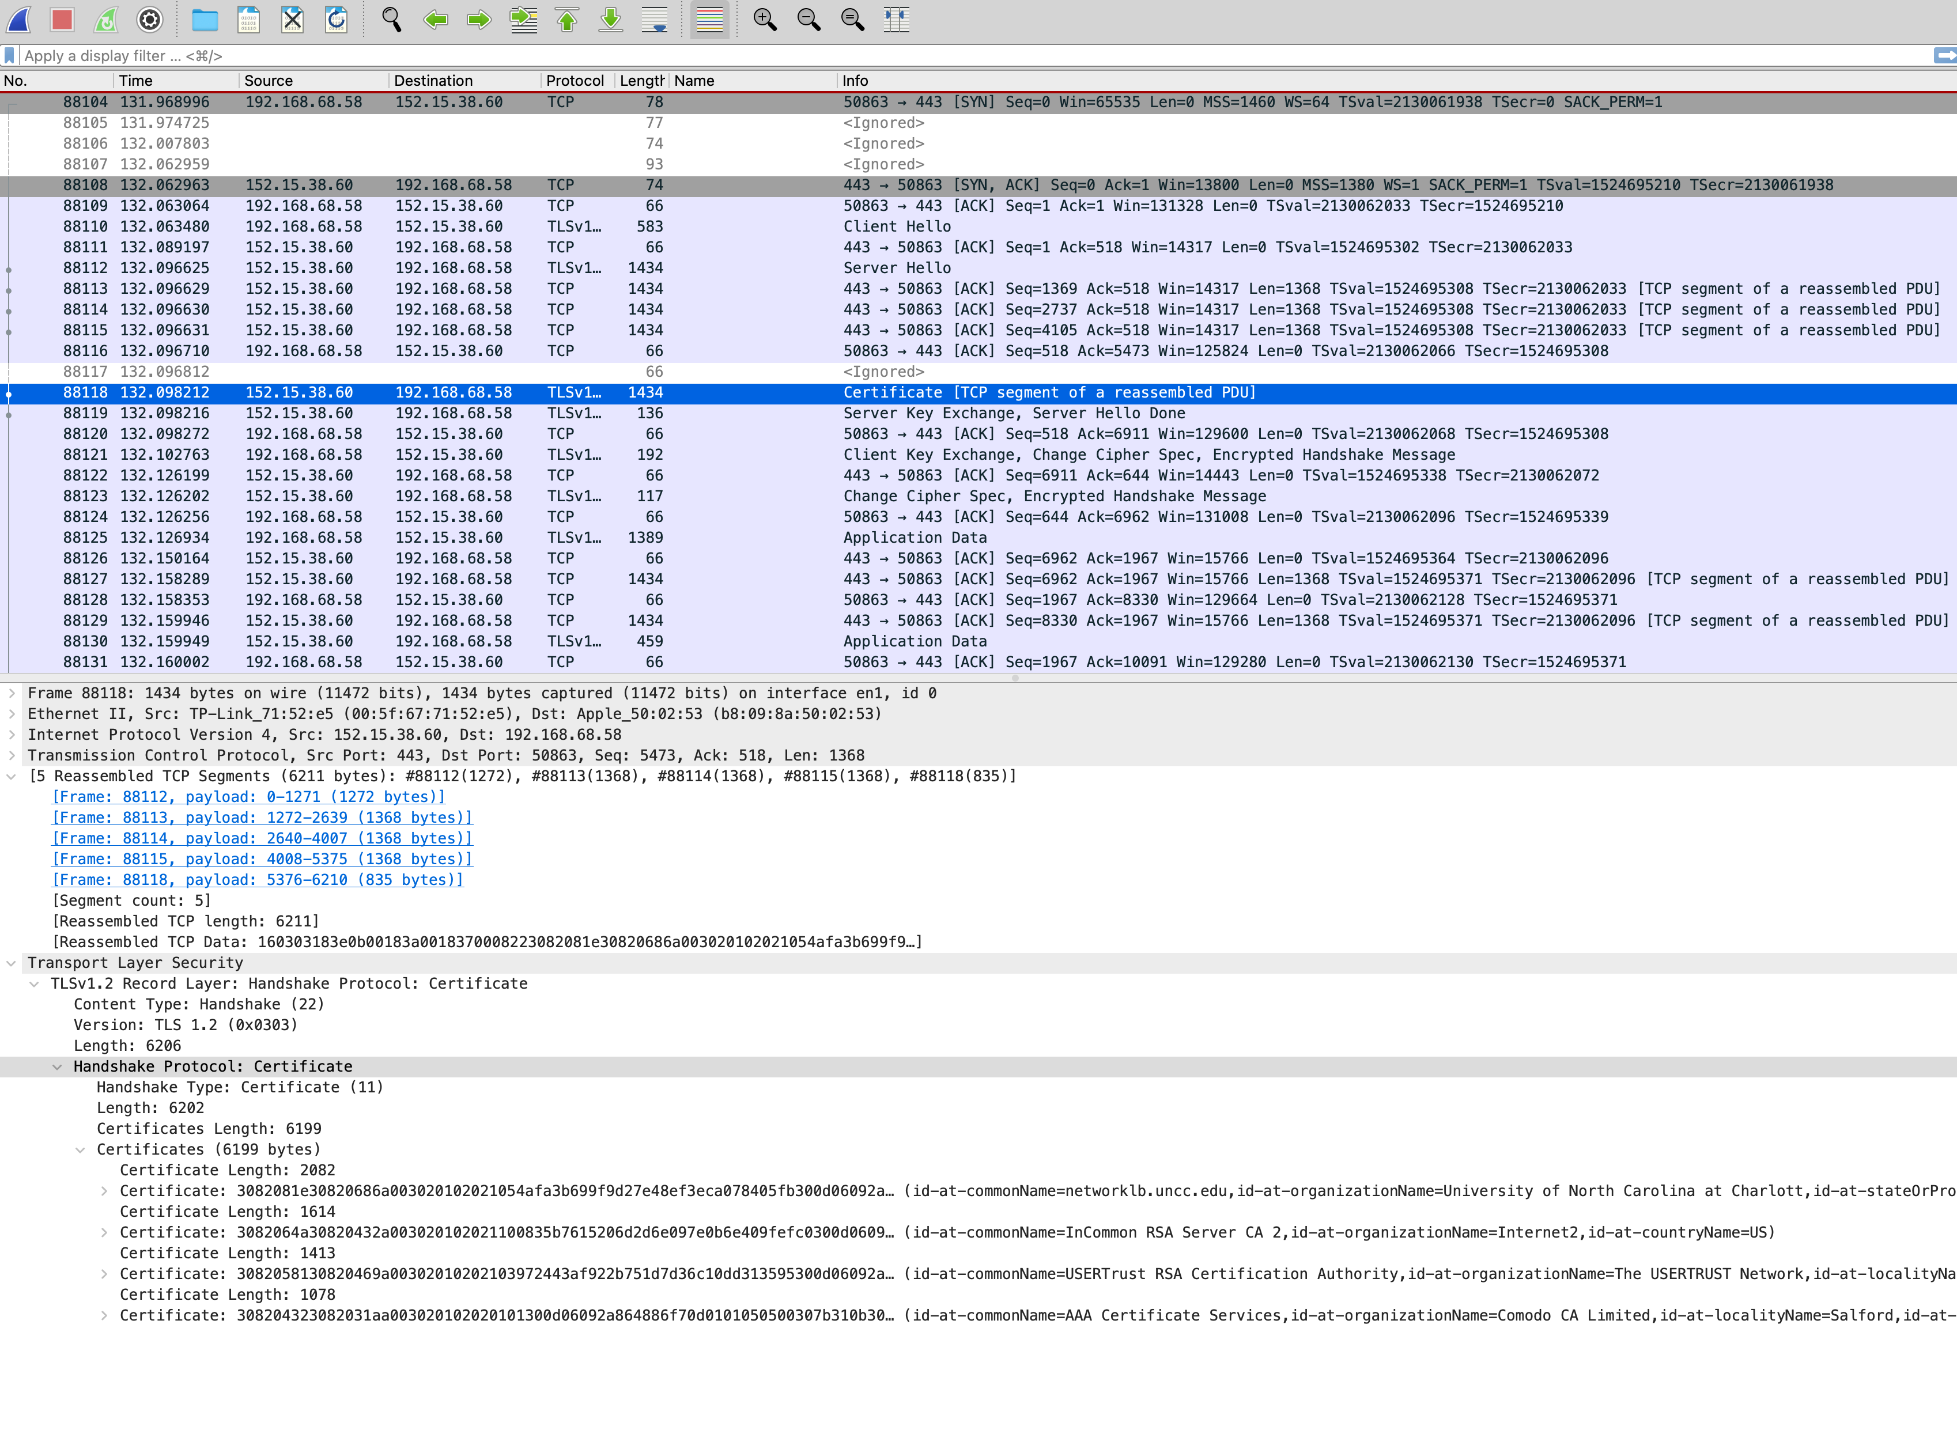
Notes:
1) What is the Client IP address, Server IP address, and their Port numbers?
2) For packet 88118, what will be the sequence number of the next TCP segment sent by the client?
3) According to the fragment reassembling, what is the MTU (maximum transmission unit) of the network, the head size of the TCP packet and the certificate size?
Identify how https works

